Slide 1
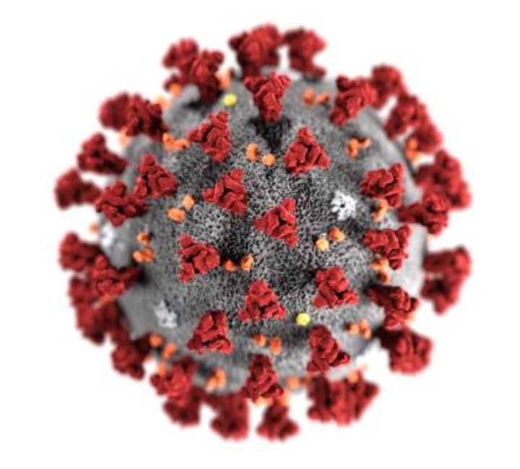


Compartmental models in epidemiology
Maria Gutierrez

Slide 2



Epidemiology
What is it?
Why study it?
What is a compartmental model?
Population is divided into compartments, assume every individual in the same compartment has the same characteristics
“All models are wrong, but some are useful.”-George Box
Notes:
Study and analysis of the distribution (who, when, and where), patterns and determinants of health and disease conditions in defined populations.

Slide 3

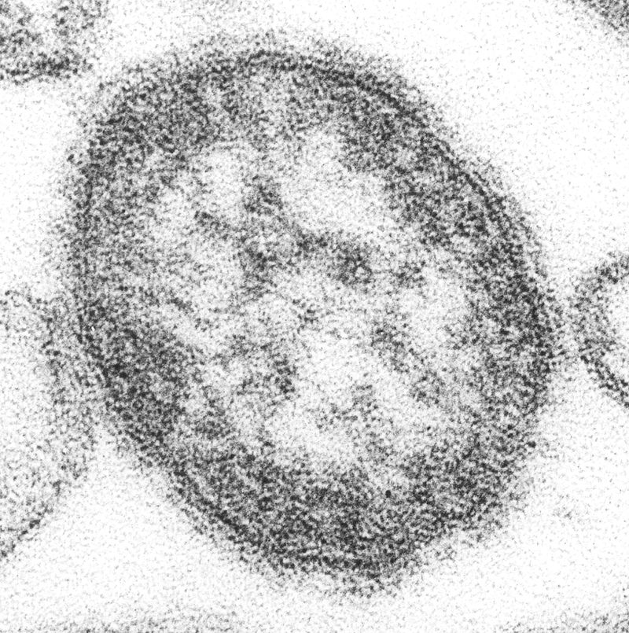
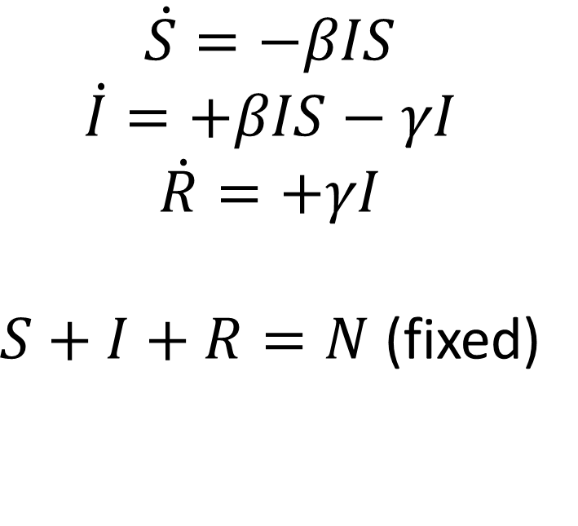
The SIR Model
*or removed
$$\dot{S}=−βIS$$
$$\dot{I}=+βIS−γI$$
$$\dot{R}=+γI$$
$S+I+R=N$ (fixed)
Measles virus

Slide 4
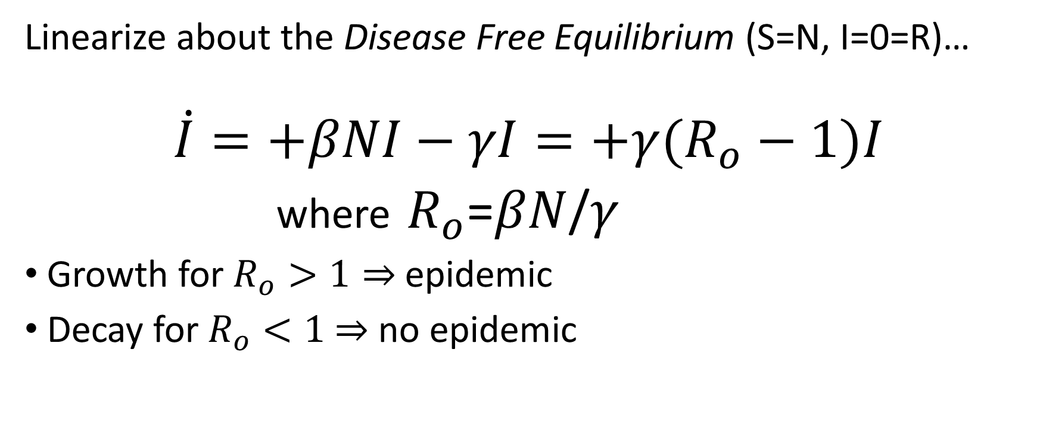
When can an epidemic occur?
Linearize about the Disease Free Equilibrium (S=N, I=0=R)…
$$\dot{I}=+βNI−γI=+γ(R_{o}−1)I$$
where $R_{o}$=$βN$/$γ$
Growth for $R_{o}>1⇒$ epidemic
Decay for $R_{o}<1$ $⇒$ no epidemic
Reproductive ratio

Slide 5
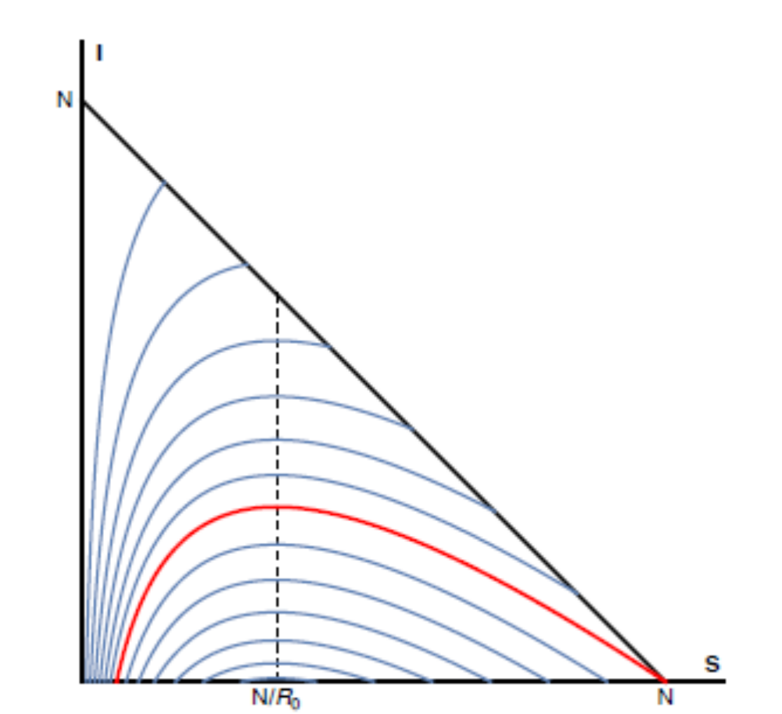
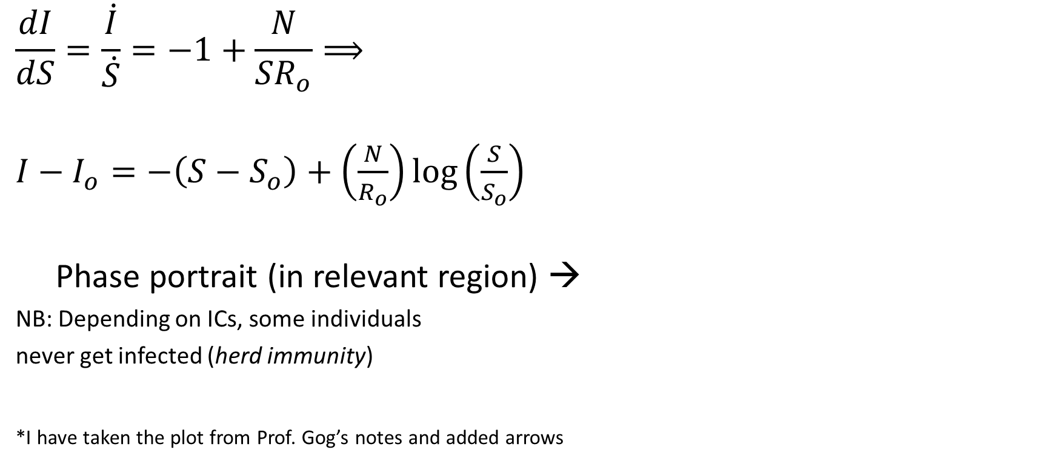
Trajectories in I-S plane
$$\frac{dI}{dS}=\frac{\dot{I}}{\dot{S}}=−1+\frac{N}{{SR}_{o}}⟹$$
$I−I_{o}=−\left(S−S_{o}\right)+\left(\frac{N}{R_{o}}\right)log\left(\frac{S}{S_{o}}\right)$
Phase portrait (in relevant region) →
NB: Depending on ICs, some individuals
never get infected (herd immunity)
*I have taken the plot from Prof. Gog’s notes and added arrows

Slide 6
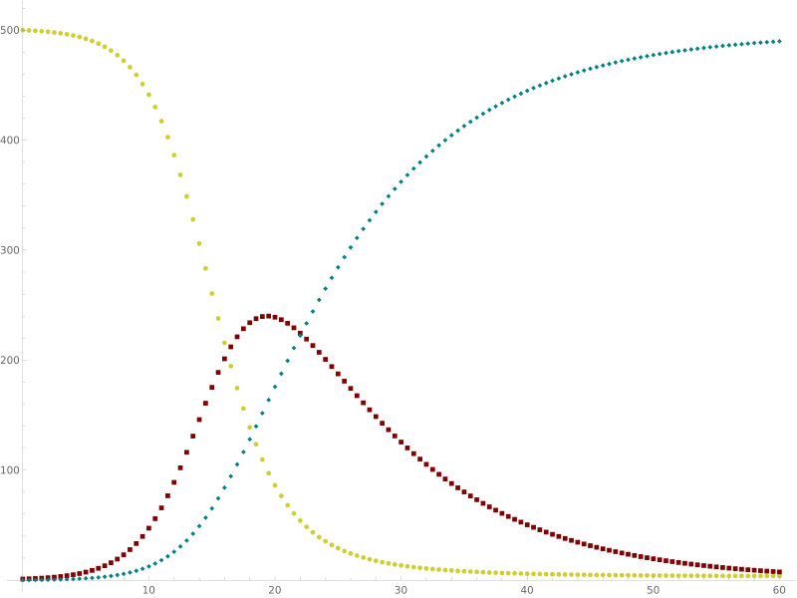
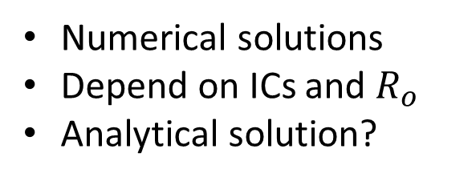
The “curve”
Removed
Susceptible
Numerical solutions
Depend on ICs and $R_{o}$
Analytical solution?
Infectious
time

Slide 7
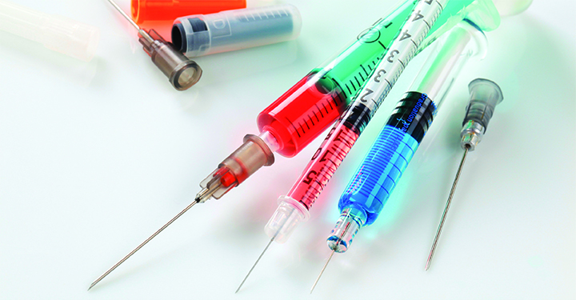

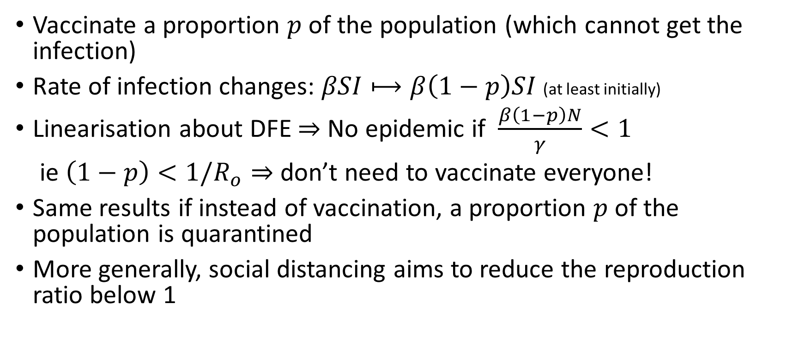
Vaccination or quarantine
Vaccinate a proportion $p$ of the population (which cannot get the infection)
Rate of infection changes: $βSI⟼β\left(1−p\right)SI$ (at least initially)
Linearisation about DFE $⇒$ No epidemic if $\frac{β\left(1−p\right)N}{γ}<1$
ie $\left(1−p\right)<1/R_{o}⇒$ don’t need to vaccinate everyone!
Same results if instead of vaccination, a proportion $p$ of the population is quarantined
More generally, social distancing aims to reduce the reproduction ratio below 1
Notes:
* If we use this to solve for the full model, we are assuming that a population p of the susceptible individuals remain vaccinated, when actually it should be higger- those that are not vaccinated have got the infection before!

Slide 8
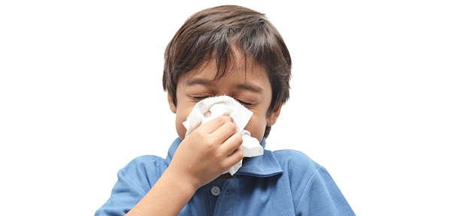


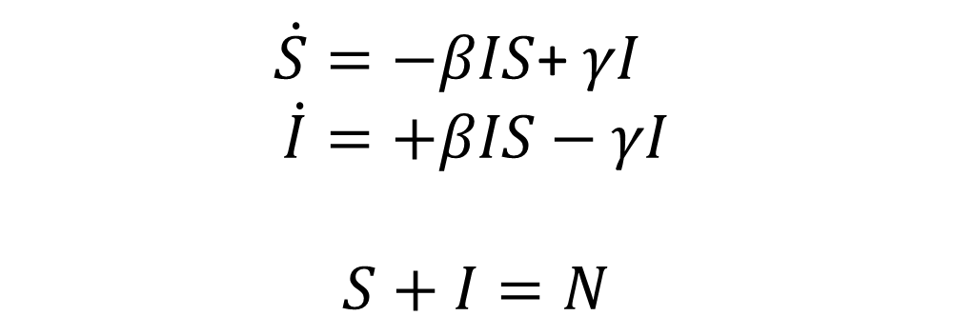
The SIS Model
$\dot{S}=−βIS$+ $γI$
$$\dot{I}=+βIS−γI$$
$$S+I=N$$
$$⇒\dot{I}=−βI^{2}+γ(R_{o}−1)I$$
Logistic equation

Slide 9
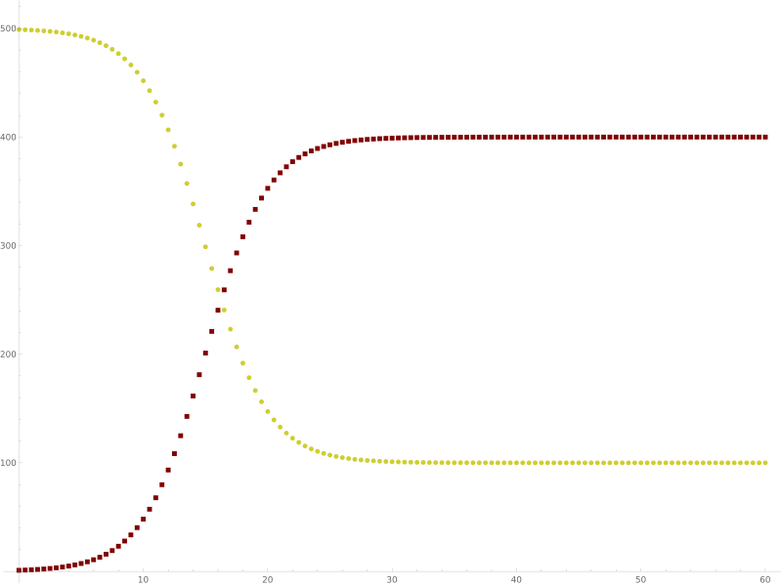
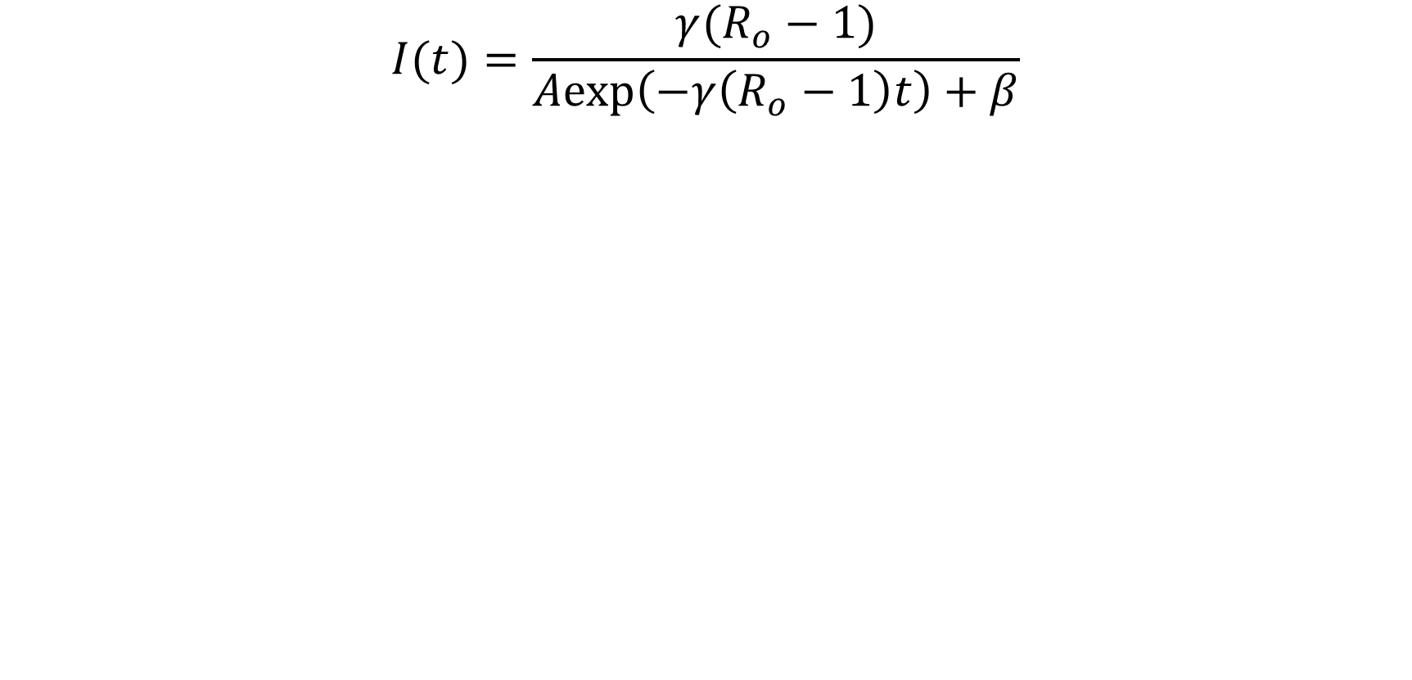
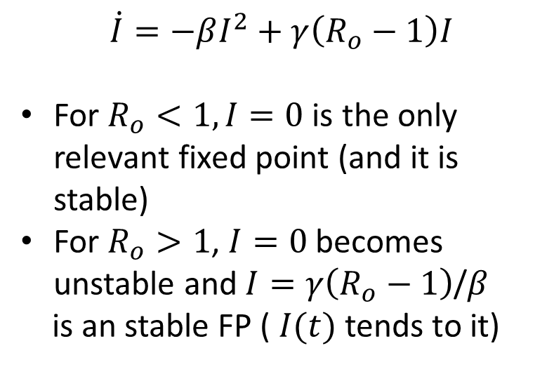
Solution
$$I(t)=\frac{γ(R_{o}−1)}{Aexp\left(−γ\left(R_{o}−1\right)t\right)+β}$$
$$\dot{I}=−βI^{2}+γ\left(R_{o}−1\right)I$$
For $R_{o}<1, I=0$ is the only relevant fixed point (and it is stable)
For $R_{o}>1$, $I=0$ becomes unstable and $I=γ\left(R_{o}−1\right)$/$β$
is an stable FP ( $I(t)$ tends to it)
Susceptible
Infectious

Slide 10


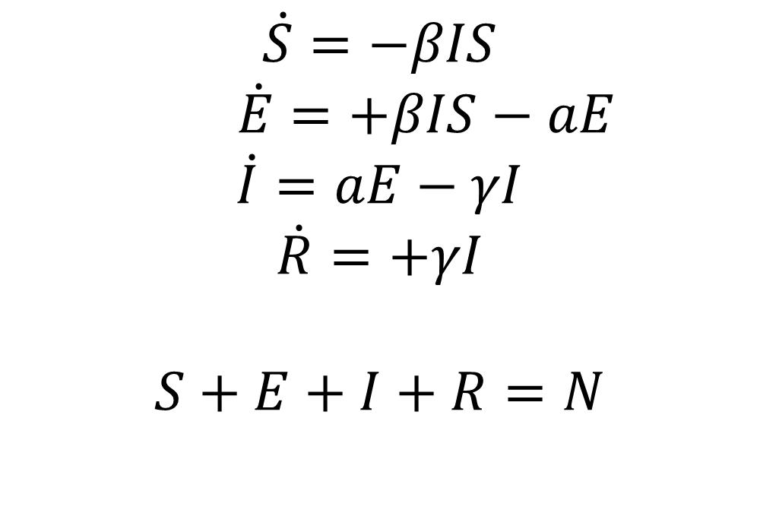



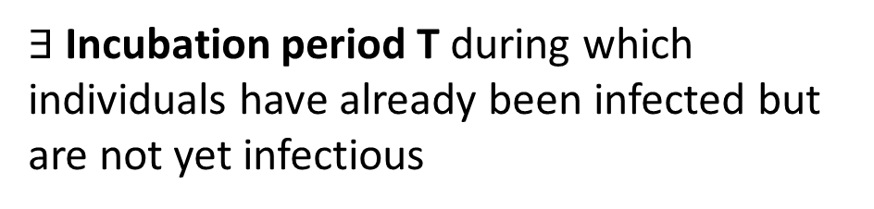
The SEIR model
$$βIS$$
$$aE$$
$$γI$$
$$\dot{S}=−βIS$$
$\dot{E}=+βIS−aE$
$$\dot{I}=aE−γI$$
$$\dot{R}=+γI$$
$$S+E+I+R=N$$
$∃$Incubation period T during which individuals have already been infected but are not yet infectious
$$𝔼(T)=1/a$$

Slide 11
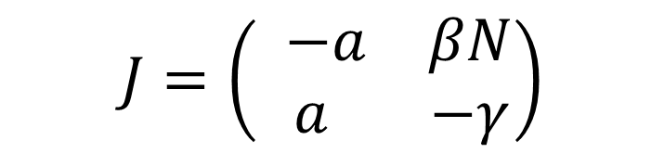
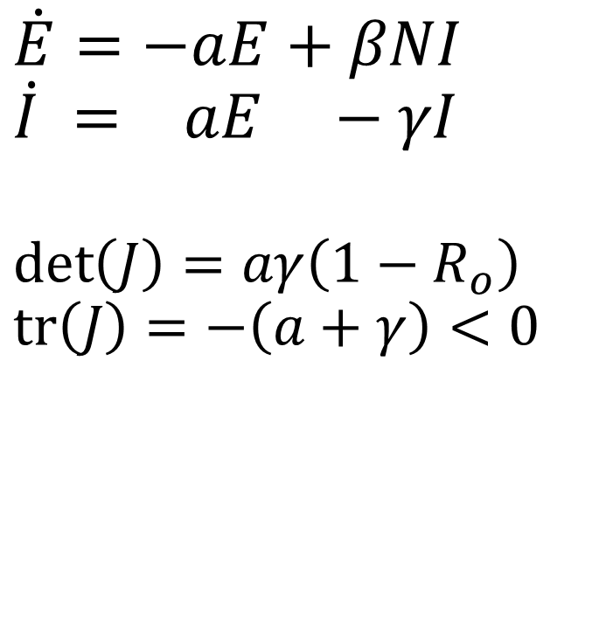
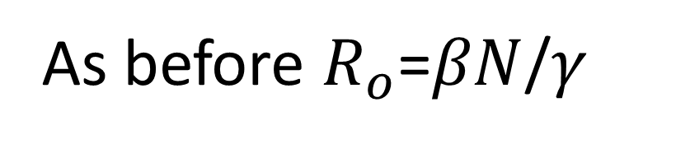
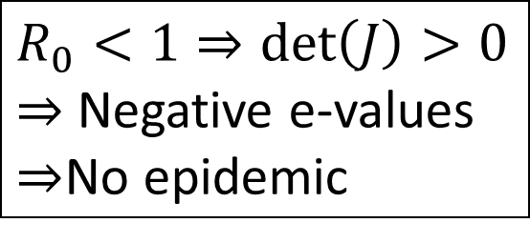
Linearisation about DFE: S=N, I=E=0
$\dot{E}=−aE+βNI$
$$\dot{I} = aE −γI$$
$$\det\left(J\right)=aγ\left(1−R_{o}\right)$$
$$tr\left(J\right)=−\left(a+γ\right)<0$$
$$J=\left(\begin{matrix} −a & βN \\ a & −γ\end{matrix}\right)$$
As before $R_{o}$=$βN$/$γ$
$R_{0}<1⇒\det\left(J\right)>0$
$⇒$ Negative e-values
$⇒$No epidemic

Slide 12
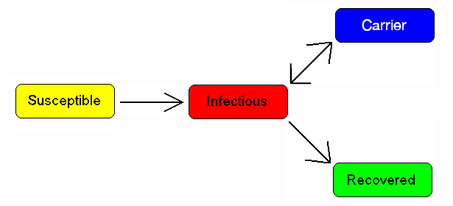
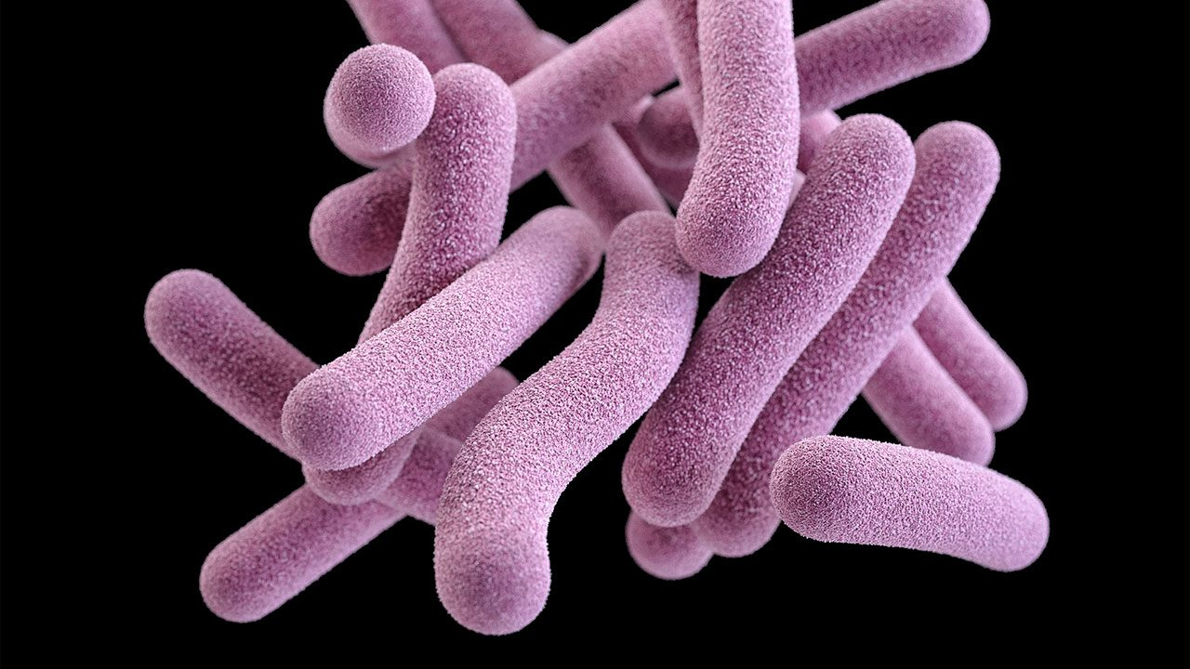
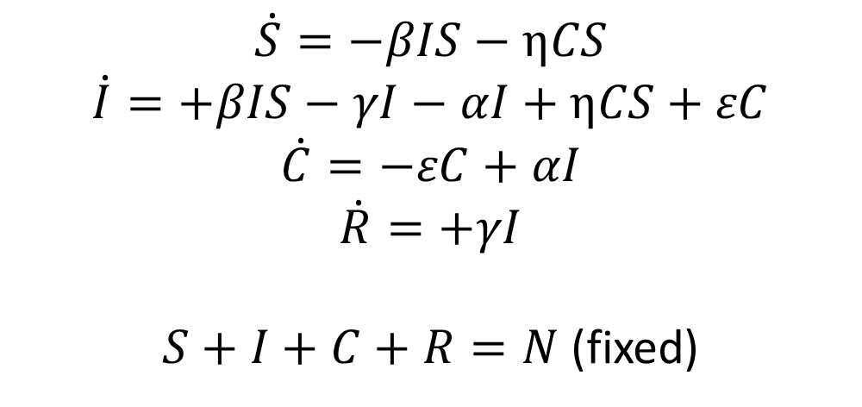




Carrier State
$$αI$$
$$εC$$
$$βIS+ηCS$$
$$γI$$
$$\dot{S}=−βIS−ηCS$$
$$\dot{I}=+βIS−γI−αI+ηCS+εC$$
$$\dot{C}=−εC+αI$$
$$\dot{R}=+γI$$
$S+I+C+R=N$ (fixed)
Tuberculosis bacteria

Slide 13


More compartmental models
MSIR: passive immunity
SEIS
MSEIR
(M)S(E)IRS: temporal immunity
SI model for Zombies: no recovery
“A” for asymptomatics
“Q” for quarantined
“Models are only as good as their assumptions.”

Slide 14
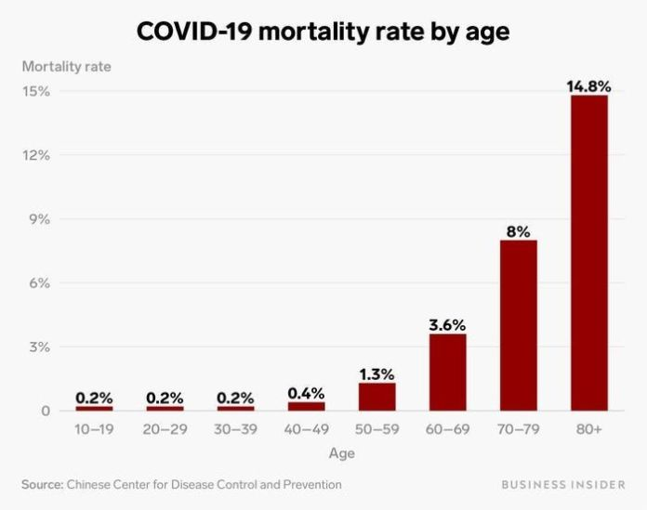
Going beyond
Vital dynamics: add natural birth & death functions
Age structured populations
Sex & other social subpopulations
Spatial structure
Statistics for parameter estimation

Slide 15

References
Prof. Gog’s Part II Mathematical Biology notes
Wikipedia page on Compartmental models in epidemiology
Allman, E. S. and Rhodes, J. A. (2003) “Infectious Disease Modeling,” in Mathematical Models in Biology: An Introduction. Cambridge: Cambridge University Press, pp. 279–314.
Robert Smith?, Mathematical Modelling of Zombies, University of Ottawa Press.
Perspectives on the basic reproductive ratio, J.M. Heffernan et al.

Slide 16


